Slide 1

By Byte the Bullet
Ahmed, Aimy, Dave, Ami
Notes:
Welcome everyone!
Today we will be presenting Happy Holiday an application I am sure you will like.
My team consists of Ahmed, Aimy, Ami and myself and together we are Byte The Bullet >> Next Slide

Slide 2



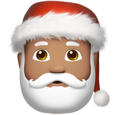

Create a wish list
Add friends and view their wish list
Each item on the wish list is either a want, dislike or dream
Create and plan events
Notes:
The purpose of the app is to help reduce the stress of Christmas shopping. I'm sure you know what I mean. Purchasing a gift for a loved one, friends or family can we hard, especially that picky someone. That is where happy holiday comes in, the app will help you navigate to items or categories your friend or family members really wants and help steers you away from items they dislike. The app allows you to create a wish list, add friends or family to the wish list in order for you to see their wants, dislikes and dreams and show and compare best price deals from the different retailers. Let's move over to Ami to talk about design.>> NEXT SLIDE

Slide 3


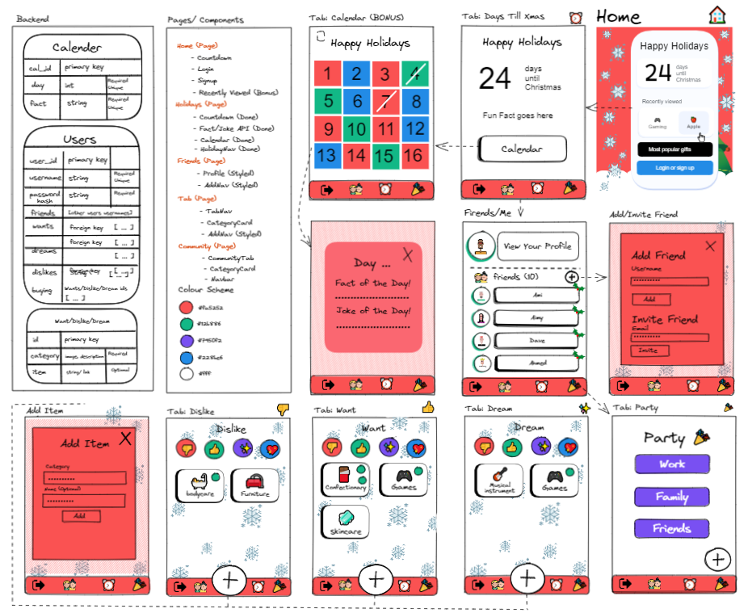
Notes:
We started by planning out the features and pages that we wanted to have on the website
We chose to use excalidraw because it allows us to quickly and easily map out the features and pages of the app and we can all access and edit the same plan
We then move on to Figma...
NEXT SLIDE

Slide 4


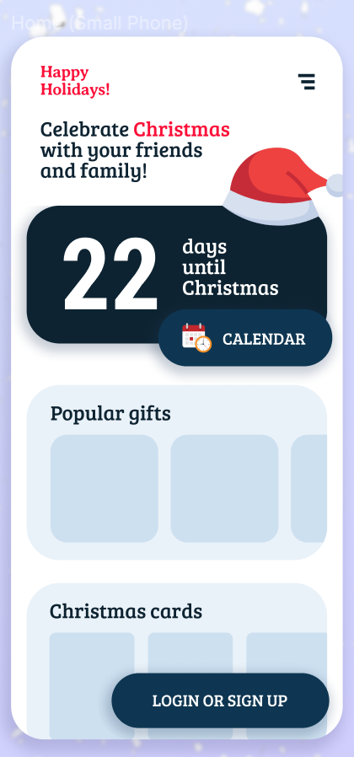
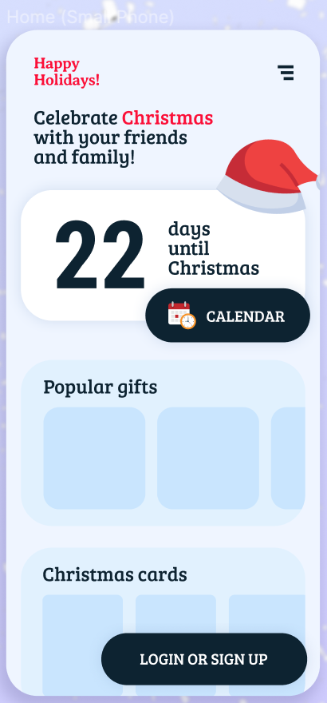
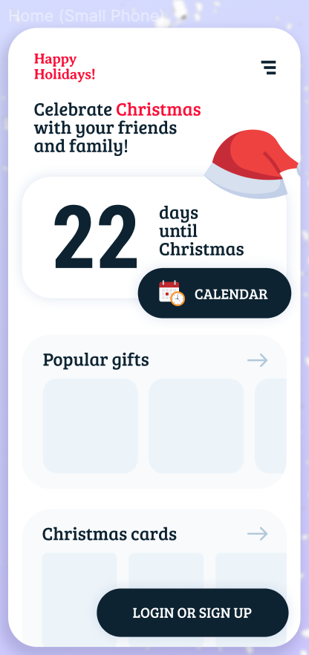
Notes:
Where we created some designs based on the excalidraw plan to further plan layout and colour scheme.
We also had a small moodboard - screenshots of mobile apps that we liked the design of that we could use for inspiration
Now I'll pass on to Aimy to talk about planning. NEXT SLIDE

Slide 5


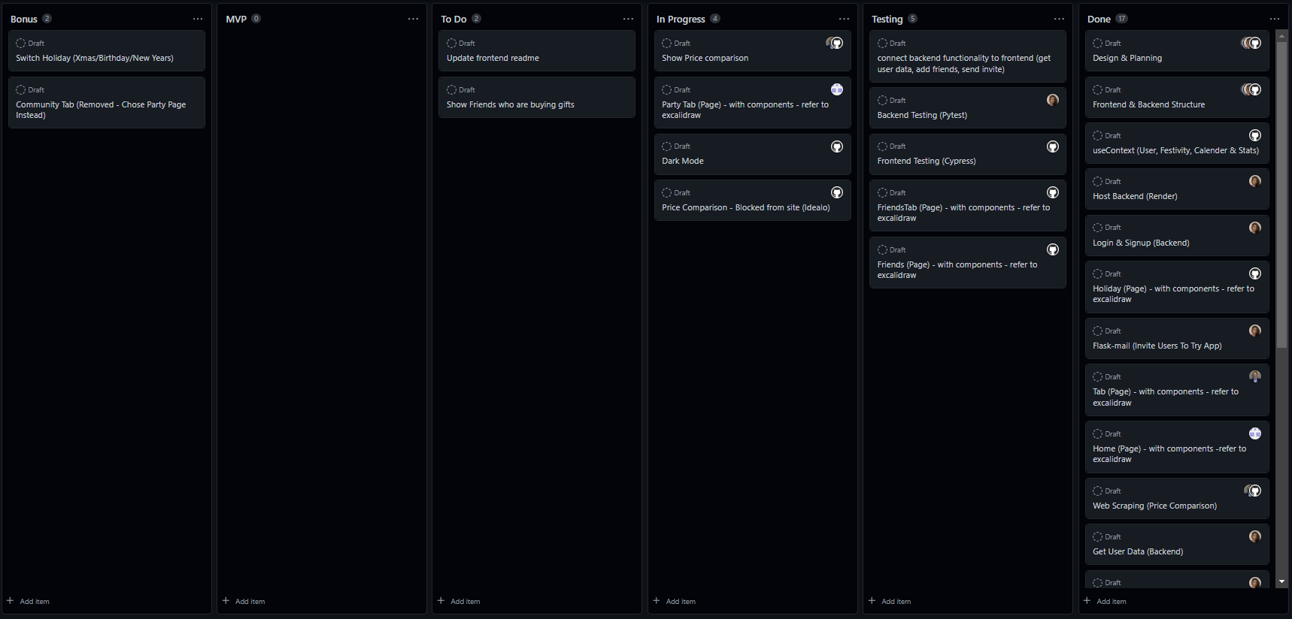
Notes:
We had daily standup meetings where we discussed our plans for the day as well as what we did the previous day and any blockers. Each member of our team would assign themselves a ticket from the MVP or Bonus pile. They would then move their ticket to the In Progress pile and then to the Done pile when they had completed the ticket. This proved to be an effective way of structuring our work and monitoring our progress. NEXT SLIDE

Slide 6










Client
Web Scraper
Server
Notes:
Ami, Ahmed and Dave worked on the frontend and web scraper whereas I worked on the backend. We used React to build the user interface of our application, Puppeteer for web scraping, and Flask to build our API. We used SQL Alchemy for our database which was integrated with Flask. Netlify was used to deploy the client whereas Render was used to host the web scraper and server. You can now see a demonstration of our app on the next slide. NEXT SLIDE

Slide 7



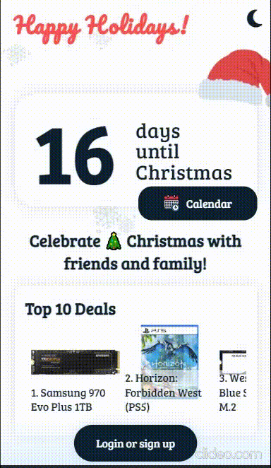
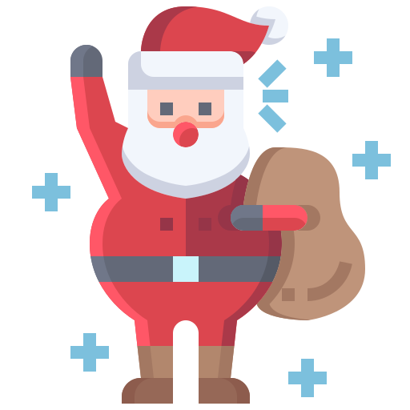
Notes:
Starting off when you enter the app, we have a section which shows you the count down days to christmas
along with a calendar we will talk about later in the presentation.
Below we have a feature of the "top 10 deals" ranked from left to right
Lets register for the application, for demo purposes we have already create 3 friend accounts and a user acccount,
so lefts sign into the users account
I ll sign in as dave and enter my password.
We are now signed in an in the home page where the count down to christmas is visible and a calendar, lets click on the
calendar.
We can see all the days crossed off including todays date, each date card has a fun fact about xmas and a corny but funny
holiday joke. Lets click back and go to the home page, in the home page lets navigate to the firneds page. In the friends
page you can see dave's profile amd underneath him the two freinds we created. We can invite a firend though email, for
demo purposes we will show you the invite a user will recieve on the following slide
For accessibility and readaiblity we have added a dark mode to the application, lets toggle back to light mode and a
add a friend. Lets add ahmed. Lets see what is in dave's wishlist.
for wants I have provide categories of shoes and clothes, you can add a item by choosing a cat and also be more specific
and add a description. I
MOVE TO NEXT SLIDE AFTER I LOGOUT

Slide 8

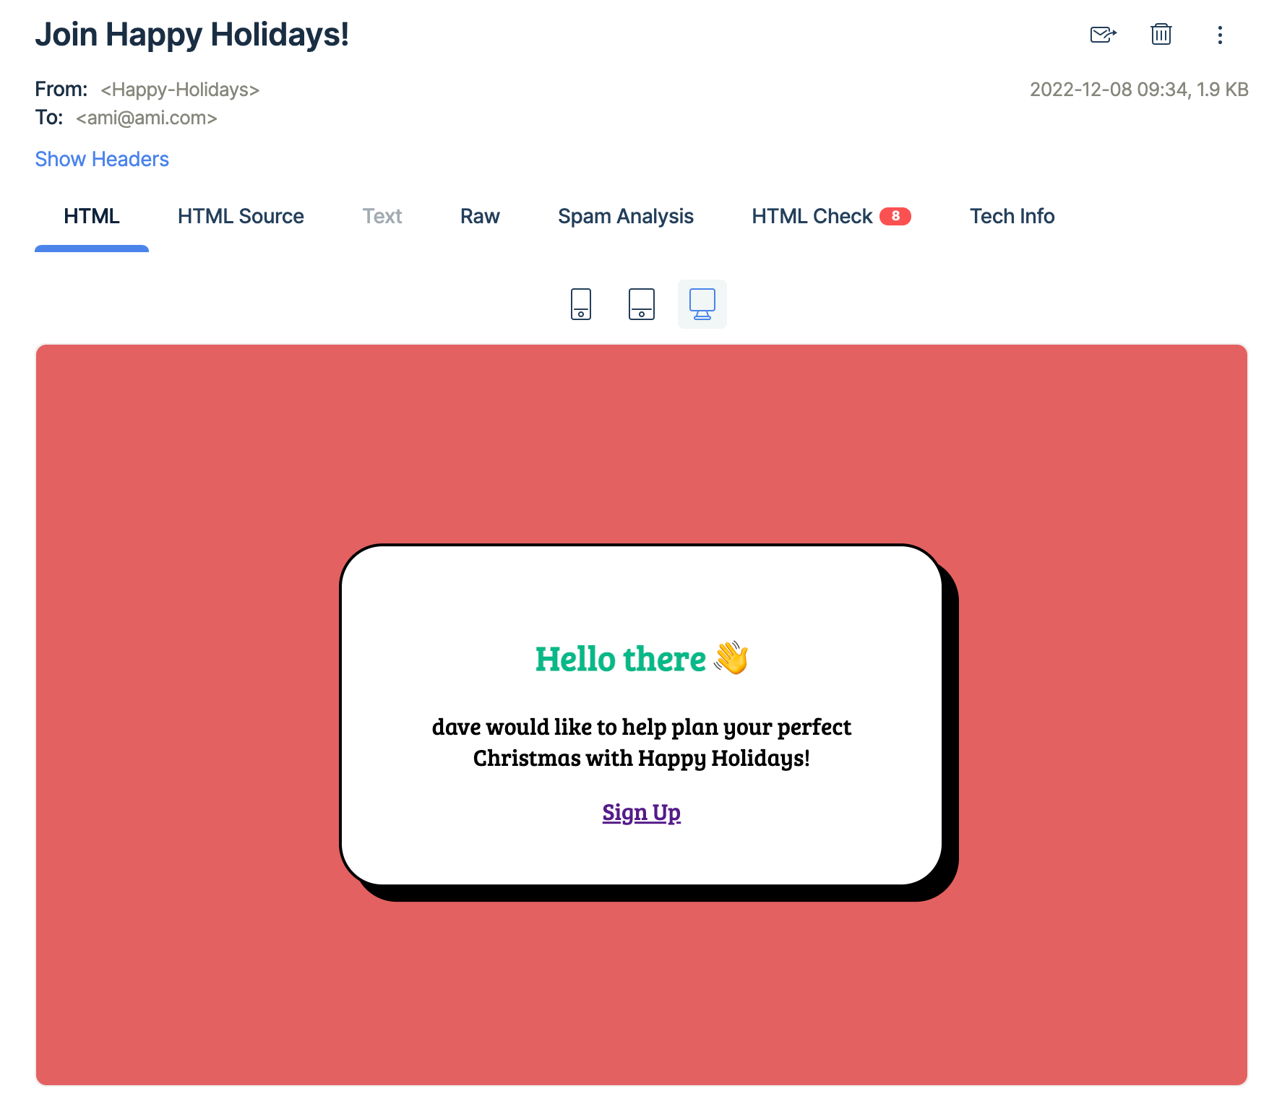
Notes:
[say something about email invite, pass to Aimy] NEXT SLIDE

Slide 9



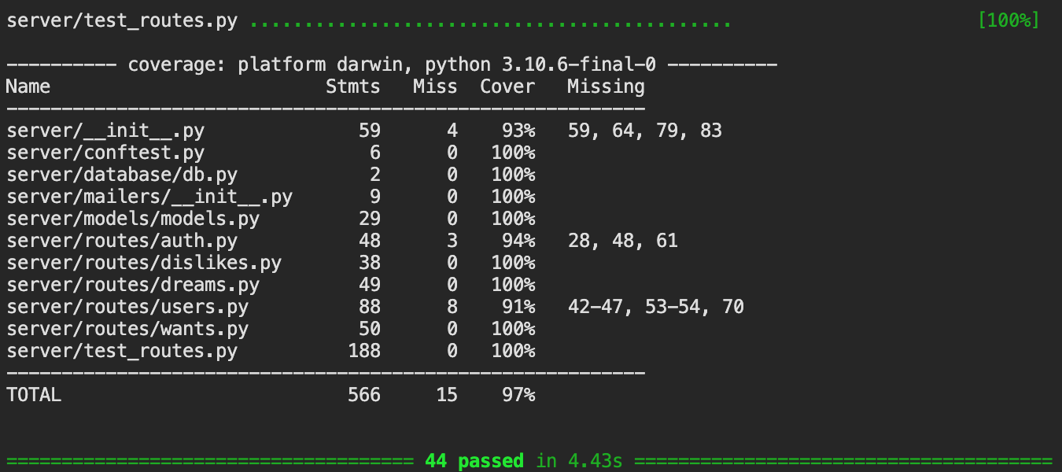
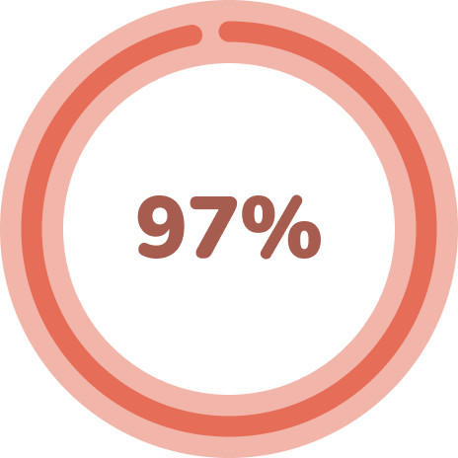
Notes:
On the backend, we managed to pass all the tests we wrote, achieving 97% test coverage with pytest. I will now pass onto Ahmed to talk about testing on the Frontend. NEXT SLIDE

Slide 10


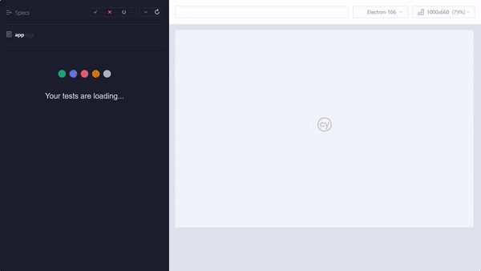
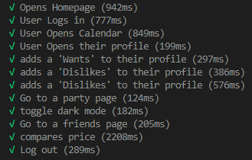
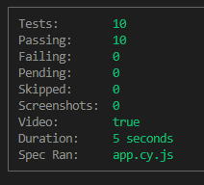
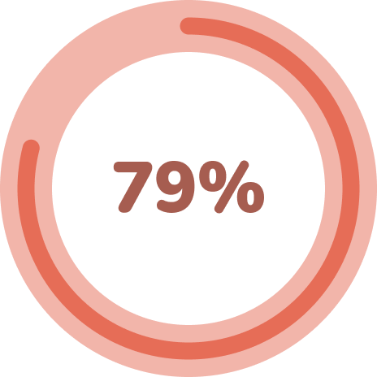
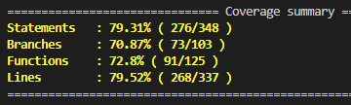
Notes:
All Ahmed:
- Achieved 79% using Cypress
- Developer-friendly testing tool
- Area of improvement
- Gif Overview
- Image on the top right (test times)
- Image on the top right (Valuable information, performance)
>> Next Slide - Moving on, we have our significant code on the frontend.

Slide 11

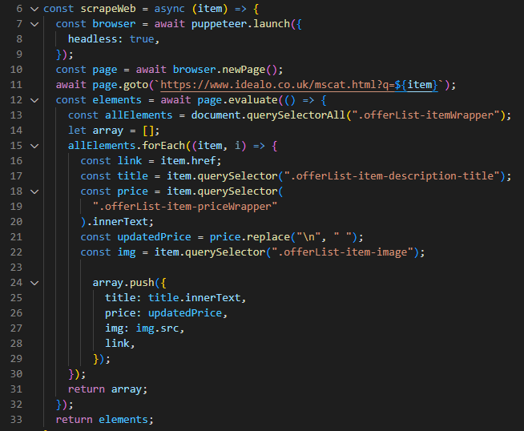
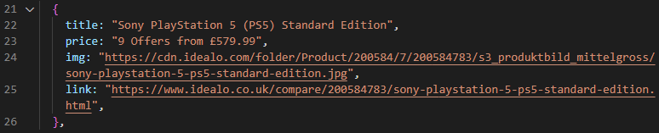
Notes:
All Ahmed:
- Purpose of this code
- Puppeteer
- line 6 (Argument)
- 7 to 11 (New browser, page & go to url)
- Setup an empty array on line 14 (Evaluate page)
- Line 13 (Targeting querySelectors)
- Then lastly, we push all the data into our array and send it over to the user.
>> Next Slide - Moving on, In terms of our Challenges & Solutions

Slide 12



Challenges | Solutions
Web scraping – Site Blocks/Captchas | puppeteer-extra-plugin-stealth Backup Scraper – Different Site
Storing arrays in SQL Alchemy (not supported) | Stored an array within a JSON object (supported)
Notes:
All Ahmed:
- Web scraping with Puppeteer Problem - (Bots, Blocked, Captchas)
- Web scraping Solution - (puppeteer-extra-plugin-stealth, Backup)
- Storing arrays Problem - (SQL alchemy, Not supported)
- Storing arrays Solution - (JSON objects)
>> Next Slide - Now I’m going to hand it over to Ami to talk to you about What we learnt.

Slide 13


Render – backend hosting
Puppeteer – web scraping
Flask mail – sending emails
Notes:
A few tools we learned to use during the project:
Render – for flask/python backend deployment
Flask mail – for notifying people when they are invited by someone, allowed us to send emails from templates designed in the style of our app
Web scraping – web scraping with puppeteer in javascript for finding information on costs of products from retailers - only 1 retailer atm but can be expanded
And for our future features... [NEXT SLIDE]

Slide 14






Chat – comments and private messages
Community – for forum posts and sharing gift ideas
Events – plan for different occasions and customise themes
Notes:
Chat – comments and private messages, mark gifts as purchased for other friends to see
Community page – for forum posts and sharing gift ideas
Change holidays – plan for different occasions and customise themes; expanding the scope of the app to any holidays and events
We really want our app to be able to be used for any and all occasions. [NEXT SLIDE]

Slide 15
Any Questions?

